Slide 1
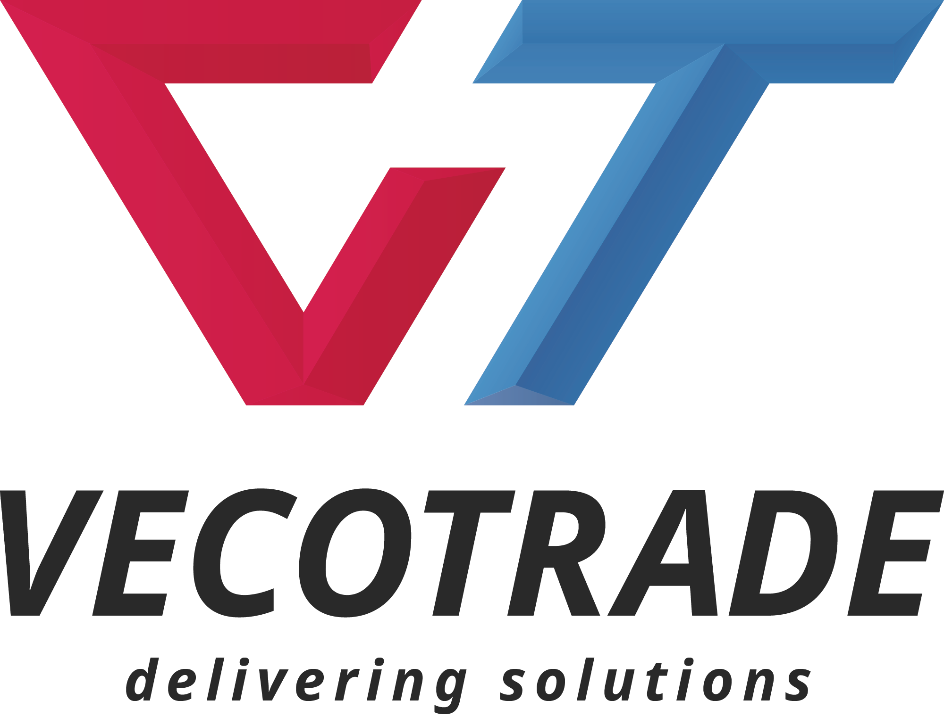
Progress for a sustainable development in Africa
8 years of business for Africa

Slide 2
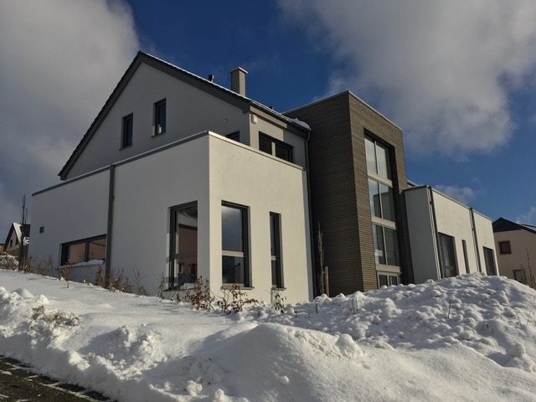
Vecotrade S.A.
Established 2004
Located in Weiswampach, northern Luxemburg
Engineering company
Turnover about 10 Mio € in 2017

Slide 3
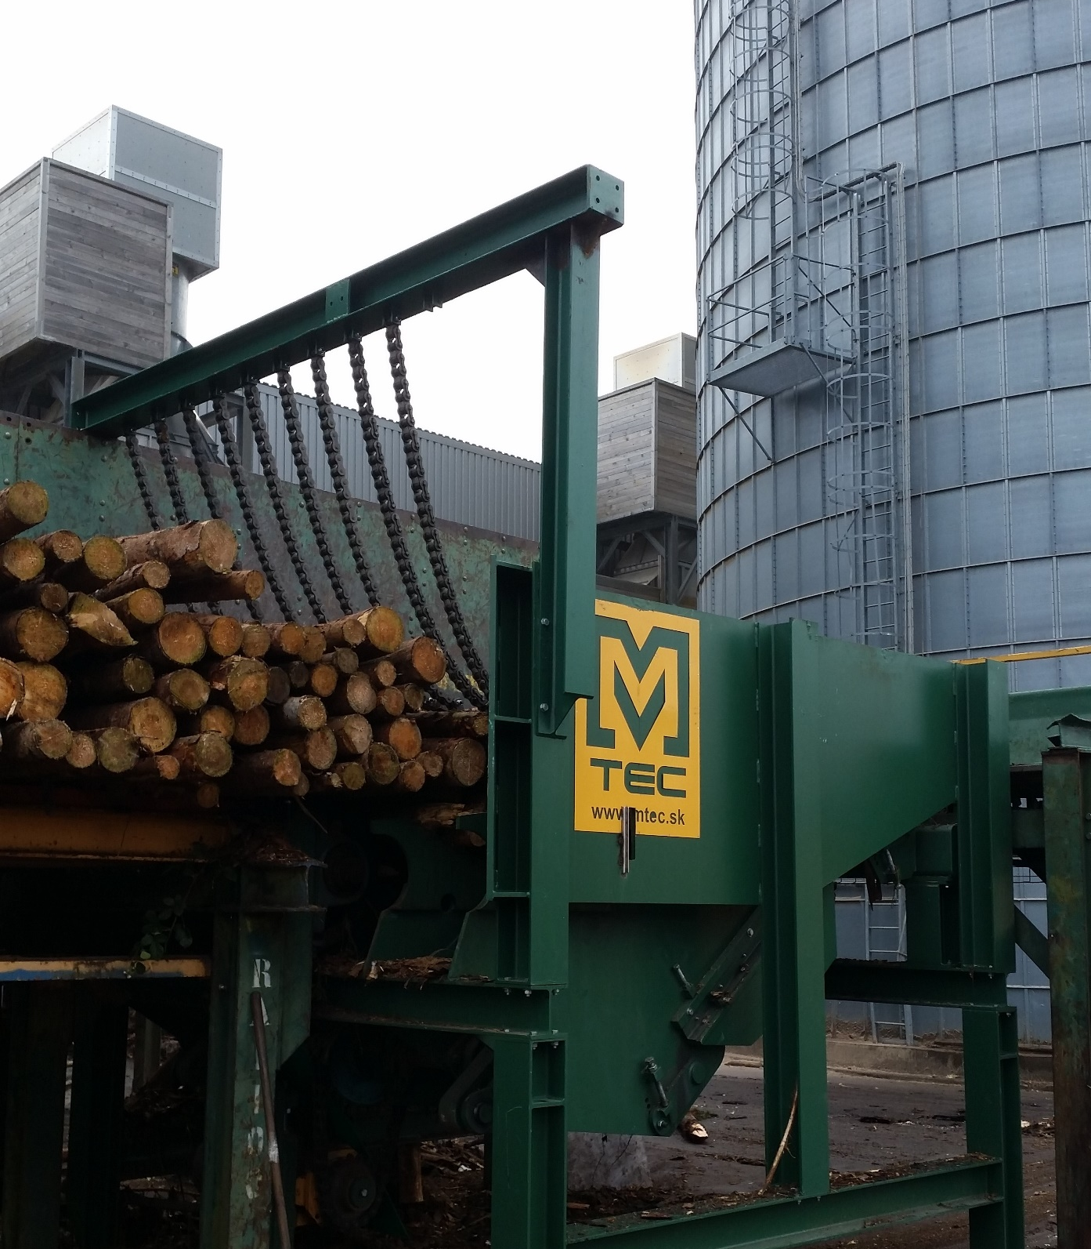
Sawmill Technology
Log handlings systems – Engineering - Construction
Saw line – Engineering – Construction - Automatization
Sawn-timber handling and waste treatment
Pellet plants – Engineering – Construction

Slide 4
Renewable primary fuel - Green fuels in palm oil production
EFB available in overflow
High-energy fibers
Kernel shells with high energy content
= ideal sustainable fuel for the plantation

Slide 5
Storage bunker for chips from rubberwood trees
3 storage boxes for the continuous feeding
of the high pressure steam boiler working
on biomass from the plantation
Automatic fuel feeding 24/7 with highest
availability – up to 99% proven over month
of production

Slide 6
Boiler feeding systems
The biomass fuel comes in the right quantity to the right time into the boiler.

Slide 7
Chipper line : production of woodchip from old rubber trees out of production

Slide 8
PLC regulated feeding system on highest level

Slide 9
Constant power supply from the turbine to the grid for the factory and the local housing settlement

Slide 10
2004 Vecotrade S.A. starts in Luxemburg
2005 First big deal outside of Europe : high technology sawmill – reinstalled in Osorno/Chile
2006 - 2008 - 2010 First biomass boiler-feeding-systems installed in Belgium
2007 Waste recycling line sold to customer in Luxemburg with shredder for RDF production
2011 First contracts for 2 boiler feeding systems with chipper, fuel storage and dosing for Ivory Coast and Gabun.
2012 Installation of the biggest pellets plant in Flemish Region (turnover of >2 Mio. €)
2013 – 2018 : 5 orders from Africa for fuel feeding systems of palm oil residues – Nigeria – Ghana - RDC

Slide 11
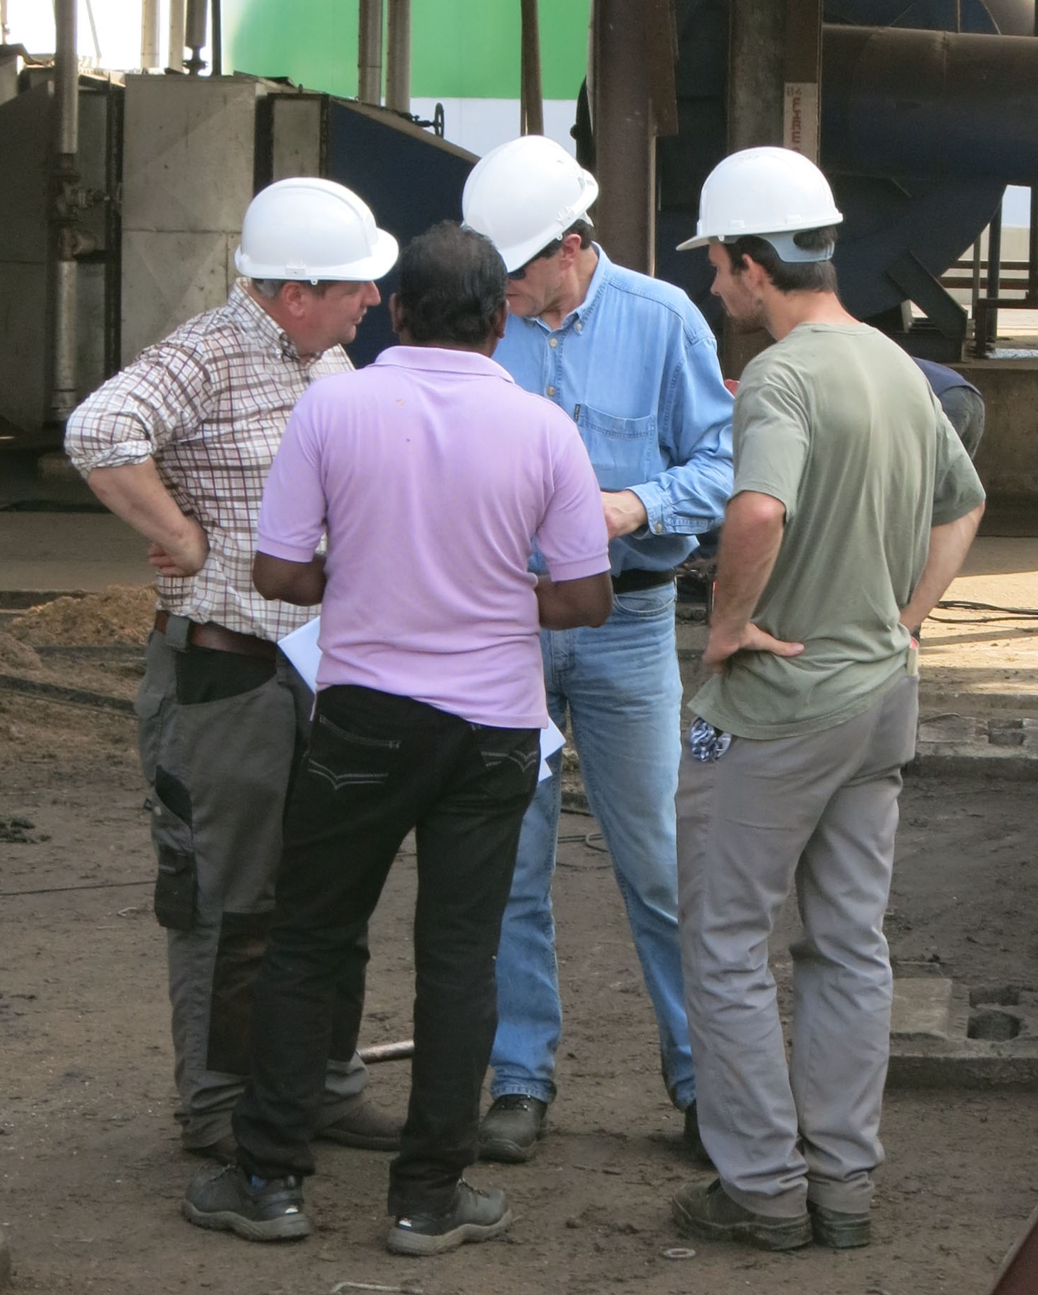
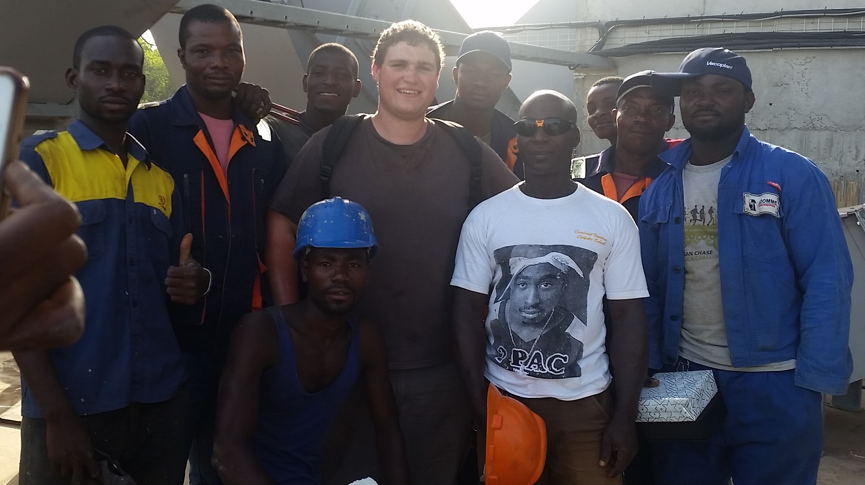
TEAMWORK is our motto !

Slide 12
Power for Africa with VECOTRADE
Vecotrade S.A.
Robert Königs
rk@vecotrade.com

